Slide 1
Advanced Lithography Technology for VLSI

Slide 2
Advanced Lithography
Introduction
Optical Lithography Review
Stepper/i-line Lithography
Stepper/i-line Process Issues
DUV Lithography
DUV Process Issues
NGL introduction
Electron-beam Lithography
X-Ray Lithography
EUV Lithography
Ion Beam Lithography

Slide 3
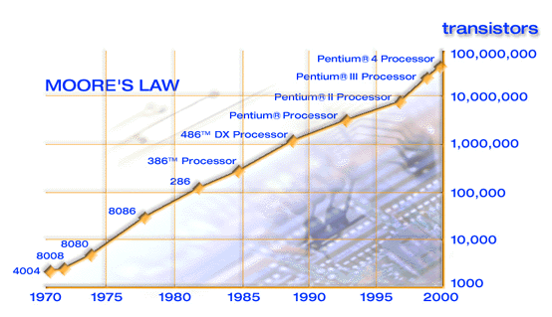
Moore’s Law
Moore’s Law predicts that the number of transistors on a chip will double every 18-24 months.

Slide 4
Moore’s Law and the ITRS
Moore’s Law is achieved by scaling down the chip, in effect you shrink the devices and pack more devices onto your chip.
This is achieved by reducing the size of the devices you print on the wafer using lithography.
By making smaller devices on the chip, the speed and functionality are increased, it consumes less power and is more reliable. And it also costs less.
The International Technology Roadmap for Semiconductors (ITRS) is an assessment by the semiconductor industry of the technological requirements in order to meet the predictions of Moore’s Law.
Notes:
International Technology Roadmap for Semiconductors (ITRS) 1999
ITRS time horizon, 15 years
To date has always had a view of continued scaling of CMOS
Future editions may have more radical approaches to further reducing the cost per function
Each node represents an approximate 70% reduction on the previous

Slide 5
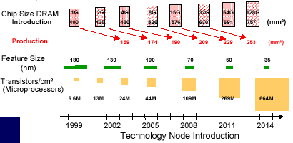
ITRS Technology Nodes

Slide 6
ITRS Lithography Roadmap
Lithography is the key enabling technology for the progression of the ITRS. It has been so successful that the current technology has accelerated beyond the ITRS.
Lithography currently represents 35% of chip manufacturing costs. This will increase further as the technology gets more complex.
For technologies down to the 65nm node (now expected to be production-ready in 2007) optical lithography techniques can now be extended to meet the ITRS.
Beyond the 65nm technology node, next-generation lithography (NGL) techniques such as electron-beam direct-write or EUV lithography will be required.
Some NGL technologies have been around for some time, but these are not yet ready for volume production.

Slide 7
Optical Lithography
Optical Lithography (photolithography) has been used to print circuit patterns on semiconductors since the integrated circuit was developed in 1958.
While the materials and equipment have become more complicated, the basic process has remained the same.
  A blanket layer of light-sensitive material called photoresist is deposited onto the wafer.
  The circuit pattern is transferred from a master copy (mask) to the wafer. The mask has clear areas (glass) which radiation can pass through, and opaque areas (chrome) which block radiation. This type of mask is called a binary intensity mask (BIM). The mask must be aligned to the previous levels before exposure.
  The photoresist is then developed to remove the areas of the photoresist that have been exposed to light. The areas blocked from the light by the chrome remain intact (positive resist).

Slide 8
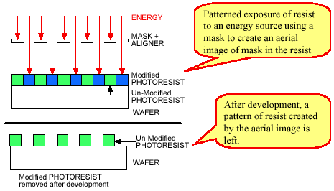
Optical Lithography

Slide 9
Optical Lithography
The main advantages of optical lithography are
  Low Cost
    Compared to the other options for patterning such as e-beam direct-writing.
  Relatively simple process and equipment
    In comparison to X-ray and e-beam exposure which require vacuum systems.
  Repeatability
    The photolithography process is very stable and provides consistent and controllable output. This is crucial for device reliability.
  High throughput (> 100 wafers per hour for 8-inch wafers)
    State-Of-The-Art CMOS processes have 20 or more patterning levels so high throughput is of paramount importance.

Slide 10
Optical Lithography
The key parameters for photolithography are:
  Resolution (R):
    the smallest pattern feature that can be printed accurately. Often referred to as the Critical Dimension (CD). For CMOS circuits this is usually the width of the transistor gate
  Depth Of Focus (DOF):
    the vertical range over which the image is in focus and can be printed accurately. Etch processes require a certain thickness of photoresist film in order to protect the substrate. Also when there is rough topography, particularly at the ‘back-end’ interconnect levels of CMOS device processes, you can have insufficient focus depth.
  Registration or Pattern Overlay:
    the different pattern levels must line up correctly with each other in order for the device to function. As your feature size gets smaller, so does the requirement for overlay.

Slide 11
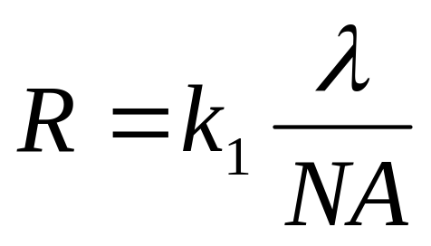
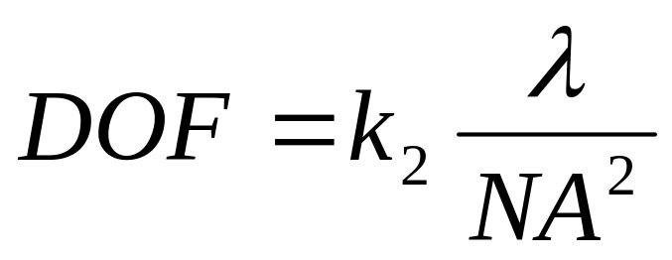
Resolution & Depth Of Focus
  λ is the exposure wavelength
  NA is the numerical aperture of the exposure system
    gives a measure of the light-gathering capability of the optics
  k₁ & k₂ are process related constants which encompass everything else in the process such as resist process, illumination scheme, reticles etc.
The simplest way to achieve smaller features is to reduce the exposure wavelength, but this impacts your depth of focus.
You can use a combination of techniques to offset the negative impact of exposure wavelength reduction.

Slide 12
Extending Optical Lithography
Reduce λ
  i-line (365nm) → KrF laser (248nm) → ArF laser (193nm) → F₂ laser (157nm)
  requires new light sources, resist processes and lens materials
Increase NA
  trade-off with DOF
  high NA lenses are much more complex and costly
Reduce k₁/k₂
  off-axis illumination (OAI)
  resist process improvement
  reticle enhancement techniques :
    optical proximity correction (OPC) & phase shift masks (PSM)

Slide 13
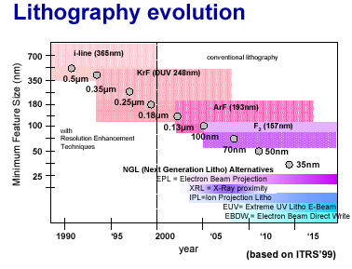
Lithography Roadmap

Slide 14
Steppers/Reticles
As feature sizes shrank to sub-micron dimensions, the use of full-wafer masks became unworkable.
  the main problem was that the lenses required to image such small features over the full wafer became too large.
The solution to this was the step-and-repeat principle
  create a single-chip pattern instead of a pattern of chips over a full wafer. A reticle may have more than one layer pattern on it.
  the single chip pattern is exposed on one small area of the wafer.
  the wafer is then stepped to a new location and the pattern exposed again. This is repeated over the full area of the wafer.
The reduced field size also allows the use of reduction optics to further shrink the pattern and produce smaller features.
  This allows you to use larger feature sizes on the mask, which can be fabricated more accurately.
Steppers also use extremely accurate automated alignment systems.

Slide 15
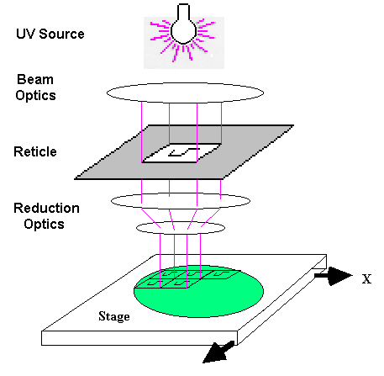
Stepper Exposure

Slide 16
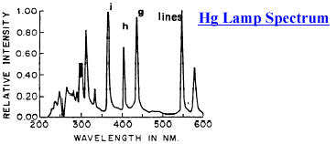
Stepper UV Sources
The mercury-arc lamp had been in wide use as a broadband UV light source for contact/proximity aligners when steppers were developed.
Steppers use mostly refractive lens components in their optics. Due to the optical dispersion of the lenses, the optics use a single exposure wavelength with a narrow bandwidth.
The mercury-arc lamp has some strong emission lines in the UV spectrum which were ideal for lithographic purposes (g-line, h-line and most importantly i-line).

Slide 17
Stepper Optics
The heart of the stepper is the optical imaging system.
  Can be thought of as having two components, the beam optics and the imaging lens.
    The beam optics ensure that the beam of light incident on the reticle is planar and of uniform intensity.
    The imaging lens (which consists of many individual lens components (typically 20 or more) in a special housing and can weigh up to 500kg). It is designed to minimise distortions and have high transmission.
  The lenses are fabricated from a special form of quartz glass called fused silica which has very low absorption in the UV region.
  Some of the more advanced steppers have adjustable lenses so that you can vary the numerical aperture of the system.
The alignment system controls the motion of the wafer and reticle stages.
  It uses laser interferometers to detect the wafer position, and then moves the wafer stage precisely using stepper motors
    For feature sizes ~ 250nm, the overlay error must be less than 30nm

Slide 18
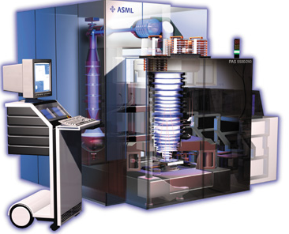
Stepper System

Slide 19
i-line Lithography
i-line lithography was the work-horse of the semiconductor industry for much of the 1980’s and 1990’s and is still used today for non-critical levels (>0.25 μm).
  Illumination is provided by a high-pressure mercury-arc lamp. The exposure optics use only the i-line (365nm) emission.
  When initially introduced, i-line steppers were 10X reduction systems with resolution of 0.7μm, NA of 0.4 and DOF ~ 2μm. The maximum field size for the chip was 10mm x 10mm.
  The most modern i-line steppers are now 5X reduction systems with resolution of 0.25μm, NA of 0.6 and DOF < 1μm. The maximum field size for the chip is 22mm x 22mm.
The type of photoresist used with i-line lithography is called DNQ/Novolac resist, which had been developed for use in previous broadband exposure technologies.

Slide 20
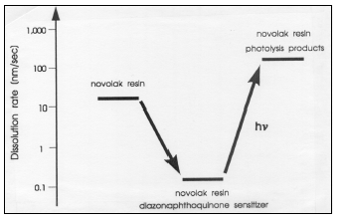
DNQ/Novolac resist
Photoresist is a three component system, consisting of:
  a polymer resin (Novolac), which gives the resist it’s physical properties
  a photoactive compound (diazonaphtathoquinone)
  a solvent (which keeps the resist in liquid form until it is applied to the wafer).
Diazonaphtathoquinone (DNQ) is the photoactive compound.
  In unexposed resist it acts as a dissolution inhibitor
  When exposed to UV radiation, it decomposes photochemically to form a carboxylic acid. This carboxylic acid is readily soluble in basic developers such as TMAH
  Difference in solubility rates between exposed/unexposed resist > 100:1

Slide 21
Wafer Topography & CMP
For most of the lithography steps in a process you are not dealing with a flat surface.
  When you etch away portions of the wafer to create the different areas of the CMOS devices, you leave peaks and troughs on the surface
Thin Films are subsequently grown or deposited onto the wafer which follow the contours of the surface.
  Due to the limited depth of focus of steppers, this can cause major problems for lithography.
A technique known as chemical-mechanical-polishing (CMP) was developed which makes a major improvement to surface flatness.
  This is achieved by grinding back the thin films to improve their surface topography.

Slide 22
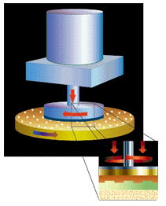
CMP Process
CMP combines the chemical removal effect of an acidic or basic fluid solution with the "mechanical" effect provided by polishing with an abrasive material
The CMP system usually has a polishing "head" that presses the rotating wafer against a flexible pad. A wet chemical slurry containing a micro-abrasive is placed between the wafer and pad.
Material from uneven topography on a wafer surface is ground away until a flat (planarized) surface is created.

Slide 23
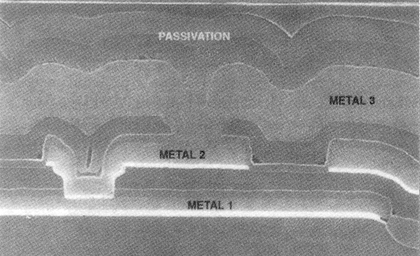
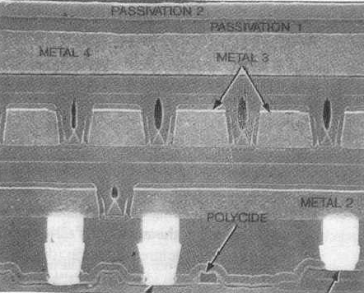
Impact of CMP
As can be seen from the pictures above, CMP makes a huge improvement to surface flatness.
  CMP can be implemented on anywhere in the process, not just at the interconnect levels.
  CMP also has the added attraction of removing particles from the wafer surface.
This allows the use of high NA exposure systems for better resolution, even with a reduced depth of focus.

Slide 24
Substrate Reflections
Exposure systems using single wavelength UV sources are susceptible to the effects of substrate reflections.
  This is even more so as very thin resist films are often used for better resolution
Light reflecting back from the surface underneath the resist cause interference effects and unwanted exposure.
  The two worst problems are the standing wave effect and reflective notching
    Standing wave effect occurs when light reflecting off the substrate interferes destructively with incoming light, leaving a standing-wave (ripple) pattern on resist line edges.
    Reflective notching occurs when you get stray exposures off steps in the topography. Resist lines are thinner over the steps. This is a particular problem once you have dense interconnect lines etched into the wafer.
These effects are worst where you are trying to pattern the highly reflective metal layers.

Slide 25
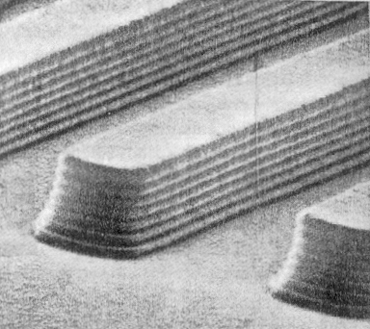
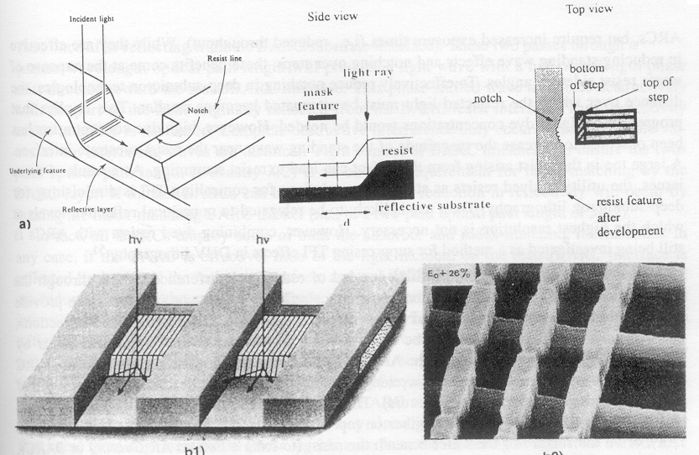
Substrate Reflections
The thinning of the resist lines (CD loss) that occurs from both these effects can be fatal.
  The main problem is complete breaks in metal lines
  Equally damaging are sub-design rule feature dimensions
    In particular for gates and contacts
Substrate reflections need to be reduced where possible.

Slide 26
Reducing Substrate Reflections 1
Dyed Photoresists
  Non-bleaching dye is added to the photoresist itself which increases the optical absorbency.
    Requires increased exposure times which reduces throughput
    Produces inferior sidewall profiles
Organic Top Anti-Reflective Coatings (TARC’s)
  These are spin-on polymer films spun on top of the photoresist.
    They work on the principle of total internal reflection
    The thickness and refractive index are carefully selected to match the incident light(index-matching)
    Incident light reflecting off the TARC/resist interface will interfere destructively with incident light reflecting off the TARC/air interface
    This reduces the reflectivity of the TARC/resist stack
    This method increases process complexity (and thus cost).
    TARC’s don’t eliminate reflective notching, so they are not much use where you have a lot of topography

Slide 27
Reducing Substrate Reflections 2
Inorganic Bottom Anti-Reflective Coatings (BARC’s)
  Very thin films (10nm - 40nm) of materials with a better absorbency than the substrate material are deposited (PVD or CVD) as the top layer of a stack. These films are conformal to the substrate.
    These ‘hard-mask’ films have the disadvantage of being difficult to remove. When possible they are incorporated into the device layer.
    For Aluminium films, TiN acts as both a BARC and a diffusion barrier.
    Silicon Nitride or Silicon Oxynitride films are also effective BARC’s.
Organic Bottom Anti-Reflective Coatings (BARC’s)
  These are also spin-on polymers, which are spun on first before the photoresist. Film thickness is usually 60nm - 120nm. They can use a number of ways to reduce reflective effects
    Absorber BARC’s absorb light reflecting from the substrate. These have a high dye concentration similar to dyed photoresist.
    Index-matched BARC’s work in the same way as TARC’s.
    Process complexity is again an issue.

Slide 28
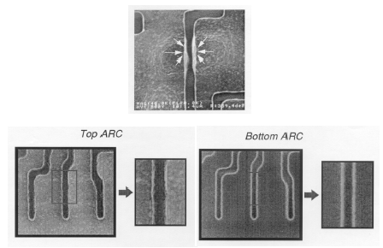
ARC effectiveness

Slide 29
DUV Lithography
The next major development in optical lithography after the huge success of the i-line generation was the DUV (deep ultra-violet) generation, which were introduced in the late 1990’s.
DUV lithography has three major differences from i-line
  DUV illumination sources are excimer lasers (initially KrF)
  Step-and-Scan systems (scanners) replaced Step-and-Repeat systems (steppers)
  DUV lithography uses what is known as chemically amplified photoresist
DUV lithography has gone through a number of sub-generations already.
  KrF (248nm) → ArF (193nm) → F₂ (157nm - still in development)
DUV will probably be the last fully optical generation.

Slide 30
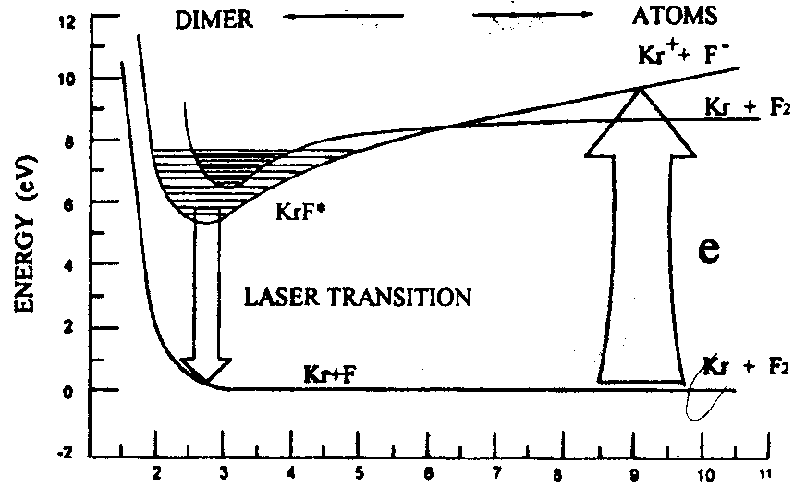
Excimer Lasers
An excimer laser contains a high pressure mixture of a noble gas and a halogen in the laser cavity (in this case krypton and fluorine).
  A high voltage pulse is applied to the gas mixture which excites the atoms from their ground state. In their excited states they form short-lived dimer molecules (the name excimer is short for excited dimer), in this case KrF*.
  The excimer states decay back to the ground state by emitting photons. A laser action is produced by stimulating the created population of excimers to decay in a very short time.

Slide 31
KrF Excimer Laser DUV Source
The first DUV excimer laser source for optical lithography was the krypton fluoride (KrF) excimer laser. This emits photons with a wavelength of 248nm.
It produces laser pulses at a rate of 2kHz, with a power output of 2-20W. It can deliver much more usable power at 248nm than a mercury-arc lamp between 235nm and 260nm. They also have very low bandwidth which allows the use of very high NA lenses.
The exposure dose is controlled by integrating the pulsed energy until the required exposure dose is reached. The laser pulses are then stopped.
KrF excimer lasers are very expensive (> $1 million) and are also quite bulky, which takes up valuable cleanroom space. The improved resolution they offer far outweighs these concerns.

Slide 32
KrF Optics
For the initial generation (0.25μm) of chips fabricated with DUV lithography, the required chip field size for CMOS chips exceeded the 22mm x 22mm chip field size available with a 0.6 NA lens on a 4X stepper.
  The multi-component refractive lens required would weigh over 1000kg, be 1.5m tall and cost millions of dollars.
The solution to this was to borrow an idea which had been used with 1X projection aligners called scanning.
  By limiting the illumination of the lens to a narrow slit, and then scanning the full length of the chip field across the slit, a larger chip field could be used while still achieving the resolution required.
This scanning action was combined with the step-and-repeat approach to produce the DUV step-and-scan systems (scanners) that are now the norm in production fabs for critical lithography exposure.

Slide 33
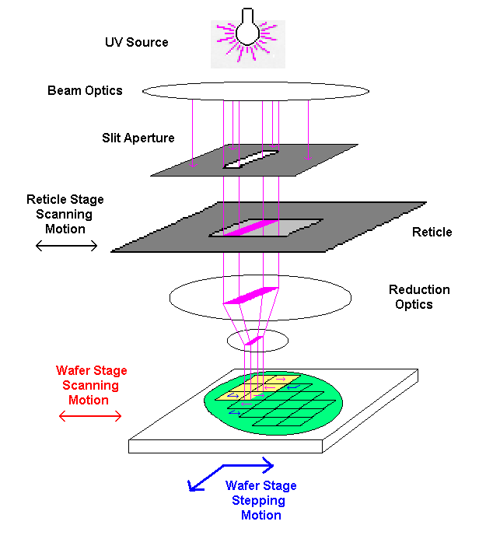
Scanner Exposure

Slide 34
DUV Scanner Technology
DUV scanners are much more mechanically complicated than steppers.
  The reticle and the wafer must be moved together at the same time at speeds up to 100 mm/sec (for 4X reduction systems the reticle moves 4 times faster than the wafer).
  While they are moving the alignment must be maintained to within a few tens of nanometers along the scan axis.
Environmental and Vibration control is vital.
  Any change can be damaging to focus control.
DUV scanners also use of wafer topography mapping.
  Before exposing the wafers, the resist thickness across the wafers is measured and the exposure dose (number of pulses) is adjusted to match local thickness variations.
  This is extremely important due to the limited depth of focus for 100nm resolution using ArF scanners.

Slide 35
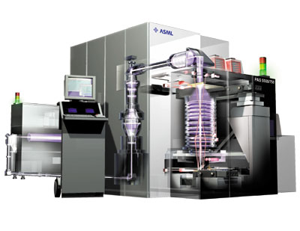
DUV Scanner System

Slide 36
DUV Lithography
DUV Lithography was introduced for 0.25μm devices.
  The first scanners were KrF 4X reduction systems with resolution of 0.25μm, NA of 0.6 and DOF ~ 0.7μm. The maximum field size for the chip was 22mm x 32.5mm.
  The latest KrF scanners are capable of resolution down to 0.13μm, with variable NA of 0.5 to 0.75 and DOF < 0.5μm. These systems require the use of enhancement techniques, in particular off-axis illumination (OAI).
  The next-generation of scanners using ArF excimer laser (193nm) sources are currently capable of resolution down to 100nm, using variable NA (0.5 to 0.75) lenses and DOF < 0.3μm. However the lenses require a new material (calcium fluoride - CaF₂) which make them difficult to manufacture and are thus more expensive.
DUV lithography required a new photoresist technology
  DNQ/Novolac resists strongly absorb radiation around 250nm, making them unsuitable for use in the DUV region.
  Chemically-Amplified (CA) photoresist was developed for this purpose.

Slide 37
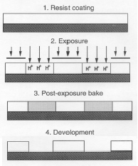
Chemically-Amplified Photoresist
In CA photoresist, the decomposition of the resist is not driven directly by the photons absorbed during exposure.
  CA photoresist is an optically transparent, acid-reactive polymer, which contains a photoacid generator (PAG).
  Absorption of photons by the PAG during exposure causes the decomposition of the PAG, which generates a small amount of acid in the resist.
  With the addition of heat (during a post-exposure bake), this photo-generated acid initiates a cascade of chemical reactions in the resist which increase it’s solubility in the developer (deprotection).

Slide 38
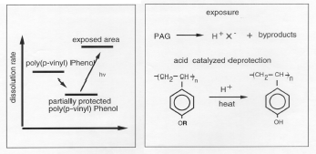
Chemical Amplification
The cascade of chemical reactions which increase the solubility of the resist are a catalytic cycle.
  The photo-generated acid reacts with the polymer in such a way that another new acid molecule is produced.
  Thus a single molecule of photo-generated acid might trigger 500 deprotection steps, hence the term chemical amplification.
CA photoresist as a result has very high contrast, giving it excellent pattern resolution qualities.
CA resists are not as resistant to dry etch as i-line resists.

Slide 39

CA Resist Processing
Due to it’s catalytic nature, CA resist is extremely sensitive.
  It is very susceptible to temperature change (which causes acid diffusion).
  It is also highly susceptible to chemical contamination, from both the air and from the substrate
Careful Process control can eliminate these problems.
  Minimize time delay between exposure and PEB.
  Special chemical filters (activated charcoal) for lithography areas.
  Organic BARC’s can help prevent contamination from the substrate.

Slide 40
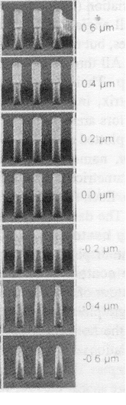
DOF for DUV Lithography
One of the principal problems with DUV lithography is the very limited depth of focus.
In order for good pattern transfer, you need to have minimal variation in linewidth throughout the whole thickness of resist.
  Ideally your centre of focus is in the middle of your resist layer
The initial DUV systems had a DOF ~ 0.7μm (or ± 0.35 μm from your centre of focus).
Even with extensive use of CMP and thin resists, surface topography can be much larger than this.

Slide 41
Top Surface (Thin-Layer) Imaging
One solution for limited DOF conditions is to use a two-layer resist process.
  A thick planarizing underlayer (~1μm) is spun on which has good anti-reflective properties, and dry etch resistance.
    This planarizing layer creates a flat surface for the imaging layer
  A thin imaging layer (~200nm) of CA resist is then spun on top.
  The CA resist is exposed and wet-developed as normal.
  The developer contains a silylating compound which causes silicon to diffuse into the unexposed areas of the CA resist.
  The resist stack is then dry-developed in an O2 plasma.
    This removes the unprotected areas of the planarizing resist while at the same time forming a silicon-oxide coat over the unexposed CA resist which protects the planarizing resist underneath.
    This dry etch process is set up to be highly anisotropic, so that there is excellent pattern transfer into the planarizing resist.

Slide 42
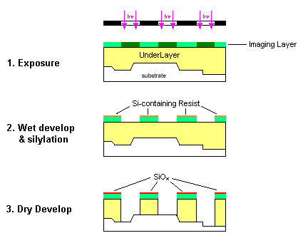
Top-Surface Imaging Process

Slide 43
Sub-Wavelength Lithography
In order to extend the resolution of DUV (and also i-line) lithography below the exposure wavelength, significant changes have to be made to the exposure conditions.
This is because the projection optical systems in steppers/scanners are limited by diffraction of the UV light as it passes through the reticle.
Technology has been developed which can counteract these diffraction effects, and allow the use of sub-wavelength lithography.
  Change the beam profile of the incident UV light.
    Off-Axis Illumination
  Change the reticle to take account of diffraction effects.
    Phase-Shift Masks
    Optical-Proximity Correction

Slide 44
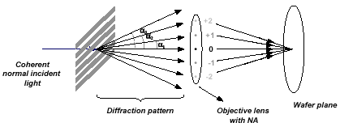
Diffraction Grating

Slide 45
Diffraction
Projection lithography is limited by diffraction.
  Diffraction occurs whenever light must pass through an aperture, so in the case of lithography, the reticle is your aperture.
  Light is diffracted into a set of beams which propagate away from the aperture only at specific angles.
  In order for an image to be reconstructed, at least one other beam, apart from the zero-order beam which passes straight through, must be transferred through the lens. For conventional lithography, the NA of a lens must be large enough to accept both the +1 and -1 first order beams.
For any given NA, there is a minimum pitch (feature size) below which the first order beams will fall outside the collection area (entrance pupil) of the lens.
A lens with higher NA would be able to capture the +1 and -1 diffraction orders, and allow the image to be formed.
  The size and cost of the lens puts a limit on how far this can go.

Slide 46
Off-Axis Illumination
A technique for improving the resolution without having to move to a higher NA lens or shorter illumination wavelength is off-axis illumination (OAI).
It works by directing the illuminating light beam through the reticle in a direction that makes the central beam pass through the projection lens at the edge of the entrance pupil (rather than at the centre as in conventional lithography).
  In this way at least two diffracted beams are captured (the 0-order beam and either the +1 or the -1 first-order beam).
  The illuminating wavelength can be used to print features smaller than that allowed by conventional lithography.
In practice, OAI is implemented by using special apertures for the illumination beam.
OAI gives best results for dense patterns (such as DRAM cells). For isolated features, no discrete diffraction orders exist, so OAI is ineffective.

Slide 47
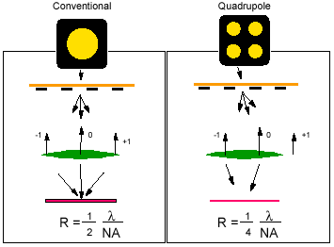
OAI Exposure

Slide 48
DOF improvements from OAI
While OAI was originally implemented purely as a resolution enhancement technique, it provides even more advantages in terms of improving DOF.
In conventional lithography, different orders of diffracted beams enter the projection lens at different radial distances from the centre of the lens.
  The different order beams (zero, first) have a different optical path length, which produces a phase difference between them.
  When the beams are recombined the phase difference results in a poorer (blurry) image the further away you are from good focus.
Using OAI, you can set up your illumination so that the zero-order and the first-order beam enter the lens at the same radial distance from the centre
  They will thus have no difference in optical path length, and no phase difference between the beams.
Carefully selected OAI angle can significantly improve the DOF.

Slide 49
Reticle Enhancement Techniques
Even with OAI, as reticle features become smaller than the exposure wavelength, interference between the diffracted light beams have a detrimental effect on the quality of image transferred to the resist.
  The pattern drawn on the reticle is not the pattern that ends up on the wafer.
In order to push deeper into the sub-wavelength region you need to counteract these interference effects.
  Interference is caused by phase differences between the diffracted beams. The phase of the light passing through the reticle can be adjusted so that the destructive interference is minimised.
    Phase-Shift Masks
  Light diffracting from one part of the circuit pattern interferes with light diffracting from another part. The circuit pattern can be created with additional features to counteract this problem.
    Optical Proximity Correction

Slide 50
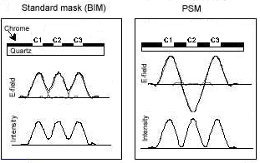
Phase-Shifting Masks (PSM)
Consider the case shown above, where three sub-wavelength openings in close proximity to each other (C1, C2 & C3).
  The light diffracting from C1 & C3 interferes with the light diffracting from C2, so that the image of C2 does not get transferred properly.
If you alter the properties of C2 only in such a way that the light passing through it undergoes a 180°phase change (indicated by the negative E-field) the interference pattern changes.
  This time the image of all three openings is transferred correctly

Slide 51
Implementing PSM
PSM requires that certain portions of the reticle have different phase properties to the rest of the reticle.
This can be accomplished in a number of ways
  In certain areas an extra layer of transmissive material of can be deposited onto the quartz glass. This material would be partially transmissive, and have a thickness carefully selected so that light travelling through this portion would undergo a 180°phase change relative to light travelling through the adjacent portions.
    Alternating or strong PSM
  The quartz itself could be etched in certain areas so that the illuminating light would pass through adjacent clear portions at different heights, giving them a different optical path length and thus a 180°phase difference when the beams recombine at the wafer.
    Attenuated or weak PSM

Slide 52
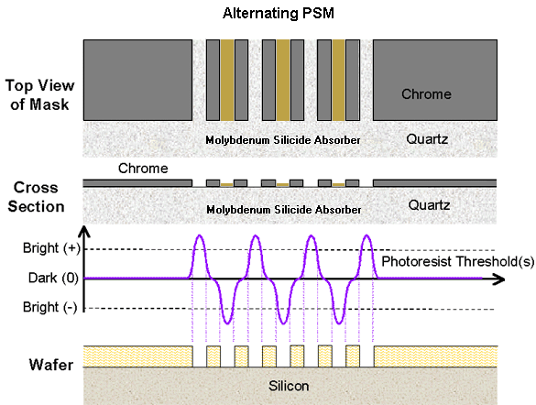
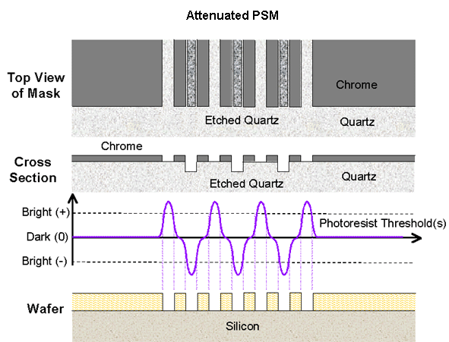
PSM Exposure
PSM is very effective at improving the pattern resolution of dense dark-field patterns (such as contact holes) or isolated line features.
  They are highly beneficial in DRAM devices where you have regular dense arrays of equally spaced structures.
The masks are much more difficult (and costly) to manufacture but this is more than compensated for by the improvement in both resolution and depth of focus.

Slide 53
Optical Proximity Correction (OPC)
When imaging at or below the the wavelength of the illuminating light, what are called optical proximity effects occur due to the effects of diffraction. These can take a number of forms.
  Linewidth bias between dense and isolated features.
    Isolated lines are printed wider then dense line patterns due to scattering from adjacent lines in the dense portion.
  End-of-Line Shortening and Corner Rounding.
    Rectangular lines are printed with the ends rounded and their length shorter than designed. Square holes end up with rounded edges. This is due to the inability of the projection lens to resolve details smaller than the diffraction limit of the lens (~λ/2).
The pattern created on the reticle can be altered in order to take this into consideration, i.e. to correct for optical proximity effects.
  In this way the proximity corrected design will print an image closer to what was originally intended than an identical design.

Slide 54
Implementing OPC
OPC can be implemented in a number of ways.
  Feature Biasing
    Line widths in isolated pattern regions are reduced compared to lines in dense pattern regions so that when printed in resist, the linewidth is the same for both isolated and dense patterns.
    Small increments (line jogs) are added to the end of lines so that when printed in resist they are the required length.
  Sub-Resolution Assisting Features
    Sometimes called scattering bars, these are features which are below the resolution limit of the system. They alter the imaging beam profile (by scattering) so as to improve the pattern quality of the device features, but because they themselves are below the resolving capability of the system, they are not transferred to the resist image.
  Serifs (Hammer-Heads)
    By adding small secondary patterns to the corners of square and rectangular features, the amount of light transmitted through the corners is increased, giving a better image of the device feature.
Applying OPC to reticles is expensive and time-consuming, but significantly improves pattern quality.

Slide 55
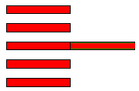
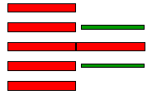


OPC Techniques
Linewidth Biasing
Sub-Resolution Assisting Features
Line Jogging
Serifs (Hammer-Heads)

Slide 56

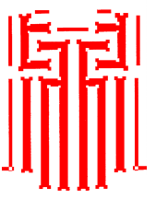
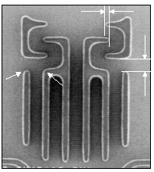
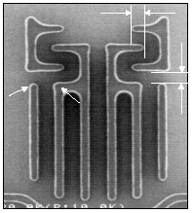
OPC Patterning
Design on
Reticle
Printed
Feature
on wafer
Uncorrected
After OPC

Slide 57
Future of Optical Lithography
The currently available generation of optical lithography technology is being used to fabricate devices with 100nm features. This should be capable of being extended down to feature sizes of 80nm or less.
  Need ArF Scanners (193nm) with 0.75 NA lenses or higher.
    The major difficulty here is the requirement for CaF₂ lenses due to the absorption of light at this wavelength by traditional lens materials such as fused silica.
  Reticles require extensive use of OAI, PSM’s and OPC in order to attain the desired resolution.
    Cost up to $50,000 per reticle.
  Photoresists for this node are available, but their performance is not as good as those for previous generations.
    Main problems are etch resistance and pattern line-edge roughness.
For technology nodes below 80nm, a new exposure technology is required. The next-generation lithography (NGL) options such as EUV and X-ray are still too costly for volume production, so one more generation of optical lithography is required.

Slide 58
F₂ Lithography
For the technology nodes down to 65nm, a new exposure technology will use the F₂ excimer laser emitting at 157nm.
The technology for this is still being developed and requires major changes from current technology, due to the absorptive properties of light at this wavelength (virtually all materials absorb light below 193nm).
  High NA lenses with reflective components (due to laser bandwidth limitations) and CaF₂ refractive components. 5X reduction required due to field size limitations.
  New reticle materials.
    In particular a new hard pellicle material is required.
  New transparent resists (fluorine-based polymers), along with ultra-thin hard-mask layers.
    Currently available resists do not meet requirements in terms of resolution, aspect ratio and etch resistance.
  Exposures at 157nm must be carried out in a purged nitrogen environment, due to the absorption of light by oxygen at this wavelength.

Slide 59
Next-Generation Lithography (NGL)
For device dimensions below 65nm, optical lithography is no longer viable.
  While it is possible to image features below this size, the elaborate exposure schemes, reticles and resists needed to extend optical lithography below 65nm are not cost-effective and the process is too marginal for high-volume manufacturing.
At this stage, NGL technology is required.
    Electron Beam Lithography
    Extreme Ultraviolet Lithography
    Proximity X-Ray Lithography
    Ion Projection Lithography
In some of these cases, technology already exists for low-volume applications and development work.
The latest version of the ITRS requires that NGL be ready for high-volume manufacturing at the 65nm technology node by 2007.
  NGL will be required for development work by 2004.

Slide 60
Electron-Beam Lithography
Electron-Beam Lithography is the best-established of the NGL technologies. There are two main technology streams.
  Electron-Beam Direct-Write (EBDW)
  Electron Projection Lithography (EPL)
EBDW is a mature technology. An electrostatically scanned beam of electrons directly patterns resist without masks.
  Principal application is mask-making.
  Currently used for prototyping and low-volume ASIC production, with resolution down to 20nm on development systems (NMRC).
  Major limitation is throughput, but improvements are being made.
EPL is a more recent development. This process scans an electron beam across a scattering membrane mask and then uses 4:1 reduction electrostatic optics.
  Currently being developed by IBM/Nikon (PREVAIL).
  Prototype machines developed, manufacturers claim to be on course for resolution and throughput requirements for 65nm node.
  Major limitation is beam control (focus and exposure dose).

Slide 61
Extreme Ultraviolet Lithography
EUVL is a recent development. It is a projection technique that uses photons with a wavelength range of 11nm to 14nm (called soft x-rays or extreme ultraviolet radiation).
EUV radiation is strongly absorbed in most materials so imaging must be carried out in a near vacuum.
Due to the strong absorption of EUV the imaging system uses reflective projection optics (aspherical mirrors) and reflective masks with patterned absorber material.
EUV reflectivity of individual materials is low, so the mirrors that comprise the EUVL projection lens are made from multilayer thin-film coatings known as Bragg reflectors.
  The chief difficulty with the technique so far has been manufacturing these reflectors, which are made from alternating layers of molybdenum and silicon.
  Technology was originally developed for x-ray astronomy.
  They have to have extremely precise thickness control (λ/4) and optical characteristics (surface shape and roughness).

Slide 62
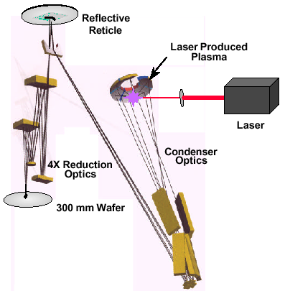
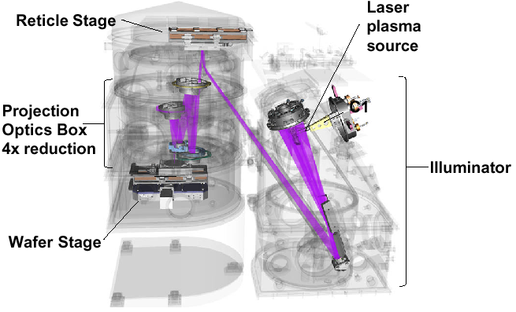
EUVL Exposure
Prototype systems have been developed as shown above.
The EUV source is a laser-produced plasma (Xenon) which emits EUV radiation at 13.4nm.
Low NA optics (< 0.1) provide good DOF and linearity for both dense and isolated structures without need for OPC.
Reticle scanning technique similar to DUV is used for exposure.

Slide 63
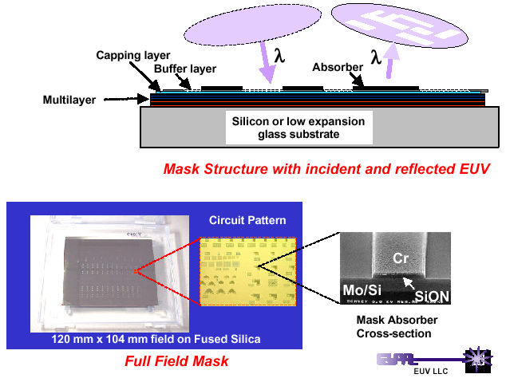
EUVL Reticle
The reticles used in EUVL are reflective not transmissive.
They consist of a patterned EUV absorber (Chrome) placed on top of a multilayer reflector, which is itself deposited on a robust substrate, such as fused silica (the materials are selected to match current manufacturing processes).

Slide 64
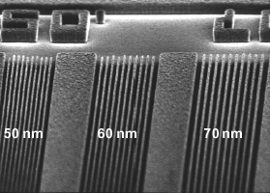
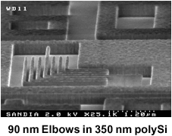
EUVL Patterning
EUVL is compatible with current DUV photoresists, even with the lower power exposure of EUV sources.
Due to the strong absorption of EUV radiation, very thin resist layers or multilayer resists( with thin imaging layers) are used.
DUV resists often have poor etch resistance, so thin hard mask layers (such as polysilicon or oxynitride) may be used instead. Experiments have been quite successful in this area.

Slide 65
EUVL Implementation
EUVL has been selected as the principal development technology for NGL, scheduled for introduction in parallel with enhanced 157nm lithography at the 65nm node.
Advantages of EUVL
  Technology most closely resembling current optical lithography.
  Resolution is extendible over a number of generations (<30nm).
  4X reduction optics with low NA (<0.1) and large DOF (<1μm).
  Compatible with current DUV photoresists.
  Throughput ~ 80 wafers/hour for 300mm wafer size.
Disadvantages of EUVL
  The multilayer reflector mirrors (aspherical) for the projection lens are extremely difficult to manufacture due to the restrictions on surface shape and roughness.
  The reflection masks are similarly difficult to manufacture, primarily because of defect density in the multilayers.
  A significant amount of work remains to be done on the exposure machine technology, particularly the alignment systems.

Slide 66
Proximity X-Ray Lithography
PXL is a well-established technology and has been in use in development lines in the USA and Japan since the late 1990’s (IBM & Mitsubishi Electric have fabricated Gigabyte DRAM prototypes with X-Ray defined gate levels).
As the name suggests, it uses short wavelength X-Rays(<8nm) as the exposure source in a proximity exposure arrangement (using a 1X reticle), eliminating the need for a complex imaging lens in the stepper.
The 1X masks used in PXL consist of a thin membrane ~ 2μm thick which is transparent to X-Rays onto which the circuit pattern has been defined in an X-Ray absorber material
PXL is compatible with both optical and DUV resists.
X-Rays used for PXL have wavelengths > 0.5nm, below this wavelength transmission through the absorber material is too great.
  With an X-Ray wavelength of ~ 0.8nm, and an exposure gap of 10μm, resolution of 80nm is achievable, with a DOF of ~ 2μm.

Slide 67
X-Ray Sources
Types of X-Ray radiation sources used in X-Ray Lithography
  Electron Synchrotron Ring (ESR)
  Laser Produced Plasma (LPP)
An ESR makes use of synchrotron radiation.
  High energy electrons emit synchrotron radiation in the form of X-Rays when they undergo radial acceleration (circular orbit).
    Produces high-power collimated X-Ray beams.
    ESR’s are large, complex systems (linear accelerator and high vacuum electron storage ring with ), each supporting a number of X-Ray steppers (up to 20 per ESR).
    They are very expensive ($20 million each) and a backup is required.
Laser Produced Plasma
  A high energy (>20J) pulsed laser (Nd:YAG or excimer) targets short pulses (10ns) onto a thin metal target, vaporizing the metal and forming a plasma that emits X-Rays as it dissipates.
    Power levels are not as high as ESR, but are being improved.
    Modular unit (1 per stepper) so costs are lower.

Slide 68
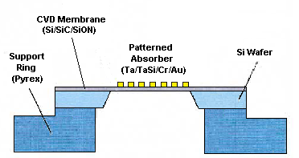
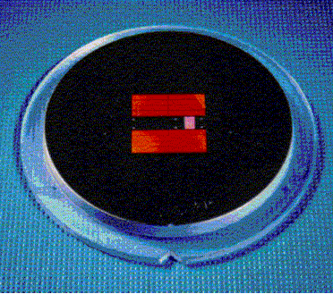
PXL Reticles
The 1X reticles used in PXL define the resolution of the system.
  The reticle base is a silicon wafer which is anodically bonded to a pyrex support ring. The membrane is usually grown as a CVD layer on the wafer.
  The Si wafer is then KOH etched to release the membrane.
  The X-Ray absorber material is deposited onto the membrane and then patterned using e-beam pattern generators.
Reticle fabrication is critical, with membrane stress, pattern placement and defect density being the limiting factors.

Slide 69
PXL Steppers
Using either ESR or LPP sources, X-Ray steppers can use full-field exposure or field-scanning.
  For full-field exposure systems, highly polished and reflective mirrors (SiC), diverge the exposure beam to the required size.
The exposure chamber can be either ambient or enclosed.
  A low-pressure helium environment offers better mask temperature control during exposure to reduce thermal distortion of the pattern.
  The low pressure also reduces membrane distortion due to turbulence.
Reticle handling systems are critical to avoid damage to the membrane. They must also be able to compensate for distortion of the pattern due to deformation of the membrane.
The wafer stage assembly controls the overlay accuracy. With current technology, the best achievable overlay is ~30nm (for feature sizes of 80nm).
Throughput for 300mm wafers has been reported at 60 wafers/hour.

Slide 70
PXL Implementation
PXL has been in development for over 20 years and has already been successfully implemented by some manufacturers.
Advantages of PXL
  Resolution is limited only by reticle pattern resolution and large field sizes can be used.
  PXL reticles are not susceptible to organic contaminants (as they don’t absorb X-Rays)
  Large DOF (~2μm) with high aspect ratios on current DUV resists.
  Throughput can match or exceed other NGL techniques.
Disadvantages of PXL
  Reticle fabrication is the limiting factor on this technology.
    Reticle yields at such small feature sizes are low, driving up cost.
    Defect density requirements difficult to meet.
  LPP sources are still under development and may not reach the required power levels in time. ESR is only viable for large fabs.
  X-Ray steppers are limited by the same alignment factors as other NGL systems.

Slide 71
Ion Projection Lithography
IPL is the least-developed option for NGL, but a European program has made significant progress in recent years.
It is very similar to electron-projection techniques, but the radiation source is a high-energy beam of positively charged ions ( the wavelength of 100keV He⁺ ions is 5X10⁻⁵nm).
The ion beam is directed by lens electrodes onto a stencil reticle. These are very similar to X-Ray reticle, but consist only of an etched membrane layer (~ 3μm) without any absorber material.
Electrostatic reduction optics (circular electrode arrays) are used to step down the pattern size of the stencil mask. NA for the electrostatic reduction ion-optical column can be as low as 10⁻⁵, compared to 10⁻³ for electron optics.
Pattern resolution of 50nm has been achieved, and should be extendible to < 30nm.
IPL is compatible with current DUV photoresists.

Slide 72
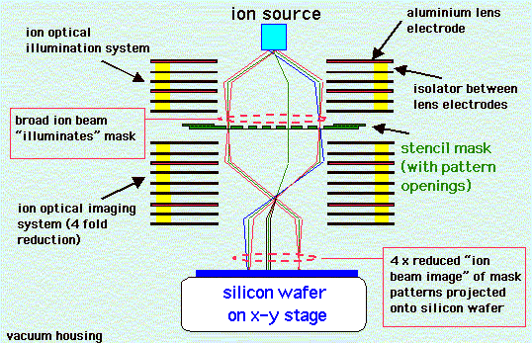
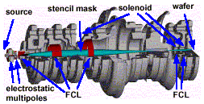
IPL System
The IPL system is based around a series of electrostatic lenses.
These are precisely manufactured, but due to their electrostatic nature, they can be ‘tuned’ to give the right beam characteristics
The whole column is under vacuum.

Slide 73
IPL Implementation
IPL is still very much in the development phase.
Advantages of IPL
  Potentially better resolution than other NGL techniques (the diffraction limit for 100keV He⁺ ions with NA= 10⁻⁵ is 2.5nm).
  Reduction ion-optics give more flexibility for reticle fabrication.
  Large DOF and high aspect ratios.
  Electrostatic optics can be adjusted much more easily than optical techniques, giving more process latitude.
Disadvantages of IPL
  Least-understood of the NGL technologies.
  Possibility of charging effects due to high beam current (ion beams have more charge per volume than electron beams).
  Radiation damage of reticles and wafers (due to ion bombardment).
  Systems are likely to be bulky, due to the electrostatic optics and requirement for cooling of the lens electrodes.

